Slide 1
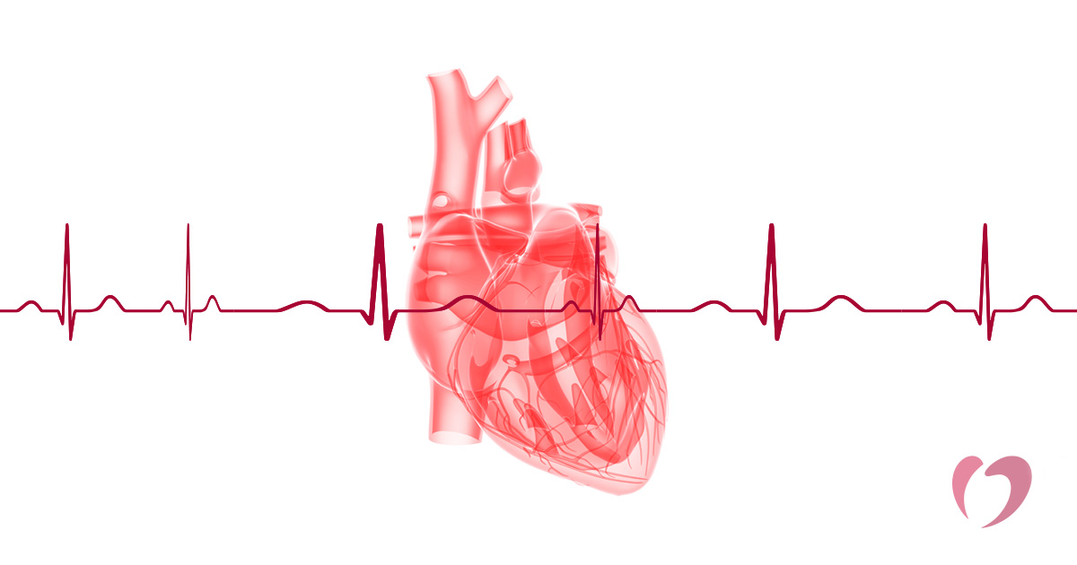
Medical physics first year
L27 Electrical Signals From The Heart-
By Assistants professor
Dr.Mohammed Ali Jaber
Physiology Department
College of Medicine
University of Basrah
/12

Slide 2
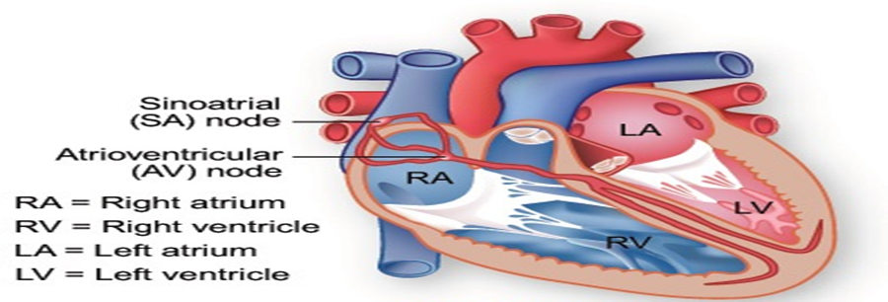
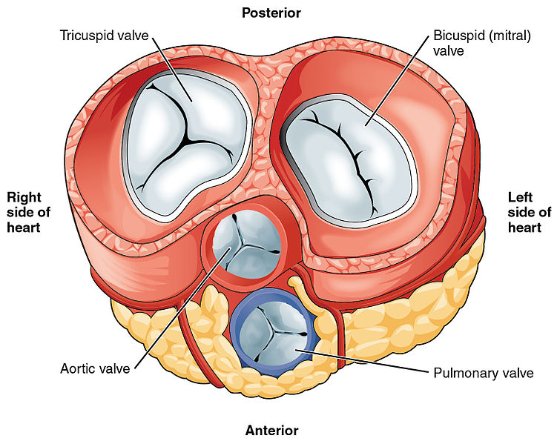
The human heart (The heart muscle)
/15

Slide 3
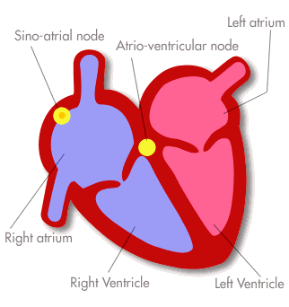
Electrical Signals From The Heart-
Sinoatrial (SA)node , or the pacemaker :special muscle cells located in the right atrium,
/12

Slide 4
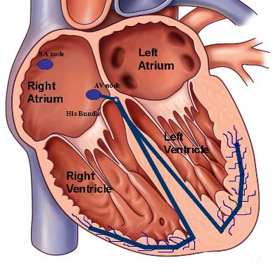
Pacemakers of the Heart
SA Node - Dominant pacemaker with an intrinsic rate of 60 - 100 beats/minute.
AV Node - Back-up pacemaker with an intrinsic rate of 40 - 60 beats/minute.
Ventricular cells - Back-up pacemaker with an intrinsic rate of 20 - 45 bpm.
4/12

Slide 5
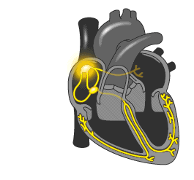
Electrical Signals From The Heart-
Depolarization and Repolarization of the atria
Atrioventriculer (AV) node which initiates the depolarization and Repolarization of the ventricles
/12

Slide 6
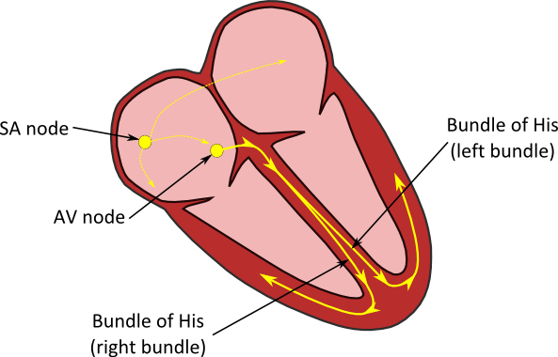
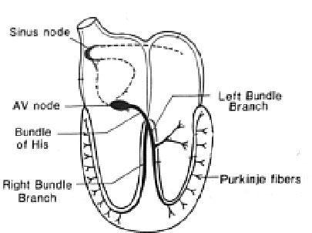
Electrical Signals From The Heart-
The record of the heart’s potential on the skin is called the electrocardiogram (ECG)
/12

Slide 7
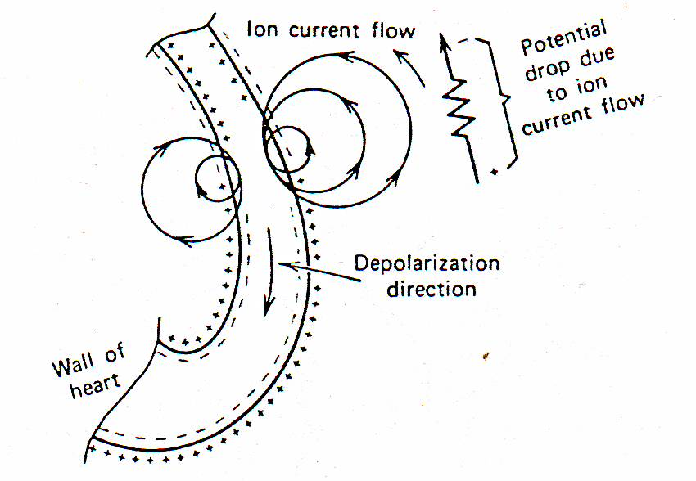
The action potential in heart
Schematic of action potential moving down the wall of the heart .
(torso)
/12

Slide 8
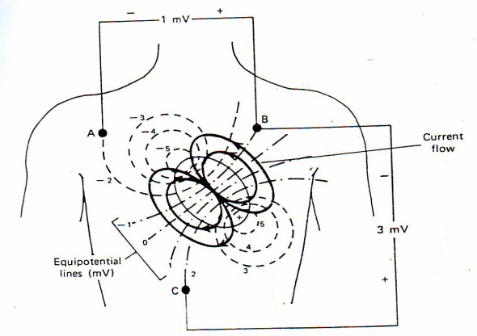
The potential distribution on the chest
The potential distribution on the chest at the moment when the ventricles are one-half depolarized
/12

Slide 9
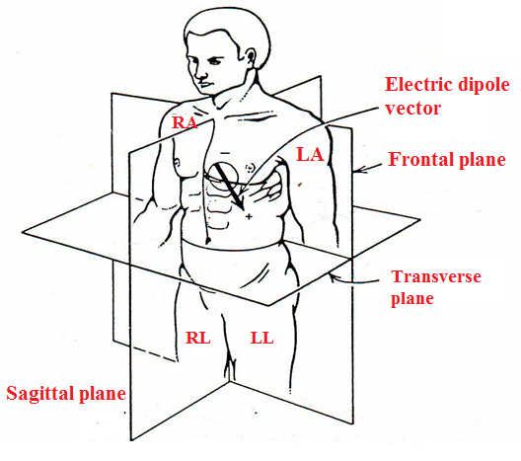
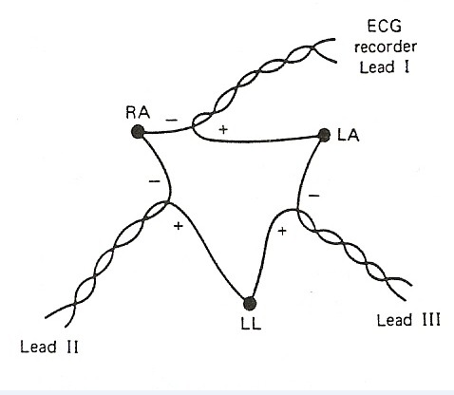
Electrocardiographic planes
Three electrocardiographic planes : Frontal plane ,Transverse plane , Sagittal plane
The surface electrodes for obtaining the ECG are the most commonly located on the : Right arm RA , Left arm LA , & Left leg LL
The electrical connections for Leads I ,II ,and III
/12

Slide 10
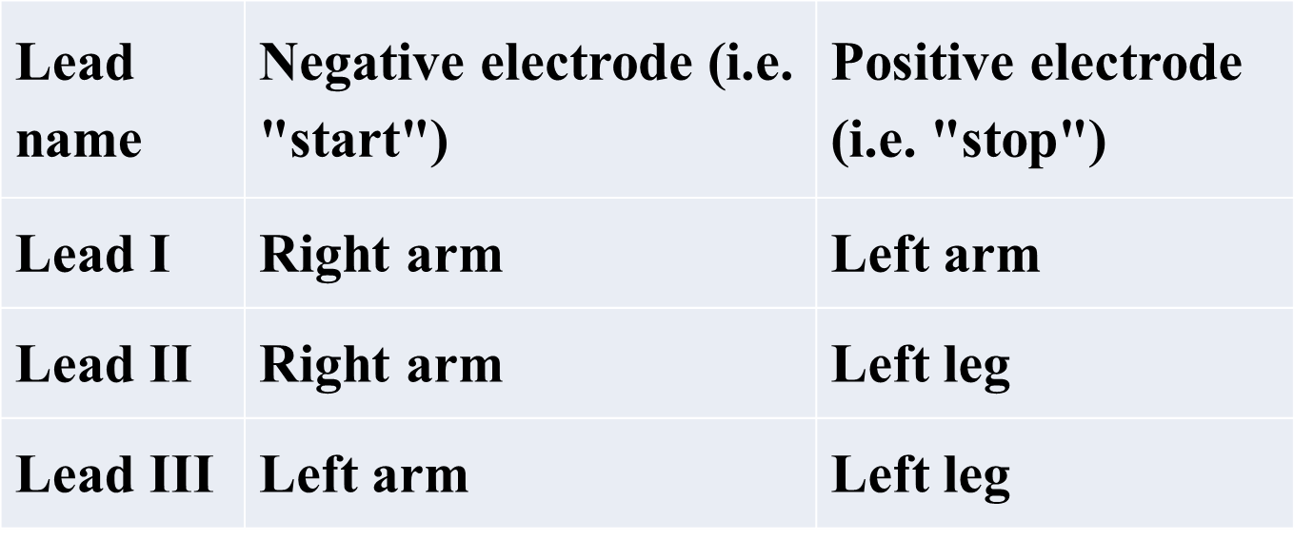
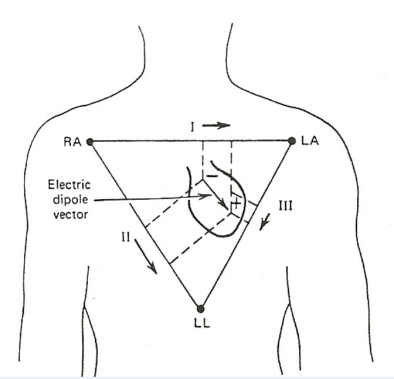
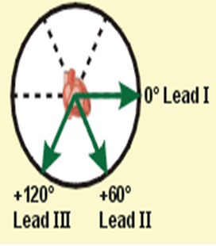
The electrical connections for Leads,(the standard limb leads).
The potential between any two gives the relative amplitude and direction of the electric dipole vector in the frontal plane
/12

Slide 11
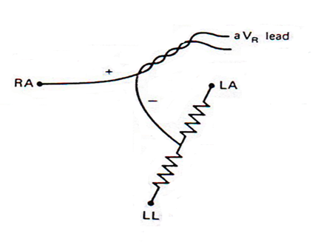
The electric dipole of the heart
The electric dipole of the heart projected on the frontal plane.
For electrical purposes the three electrodes (RA , LA , and LL ) can be thought of as the points of a triangle , the Einthoven triangle.
An augmented lead (the unipolar limb leads AVR ، AVL ، AVF ),
A six unipolar chest leads, also called precordial or V leads,( V_{1,}V₂, V₃,V₄,V₅, and V₆)
/12

